Slide 1
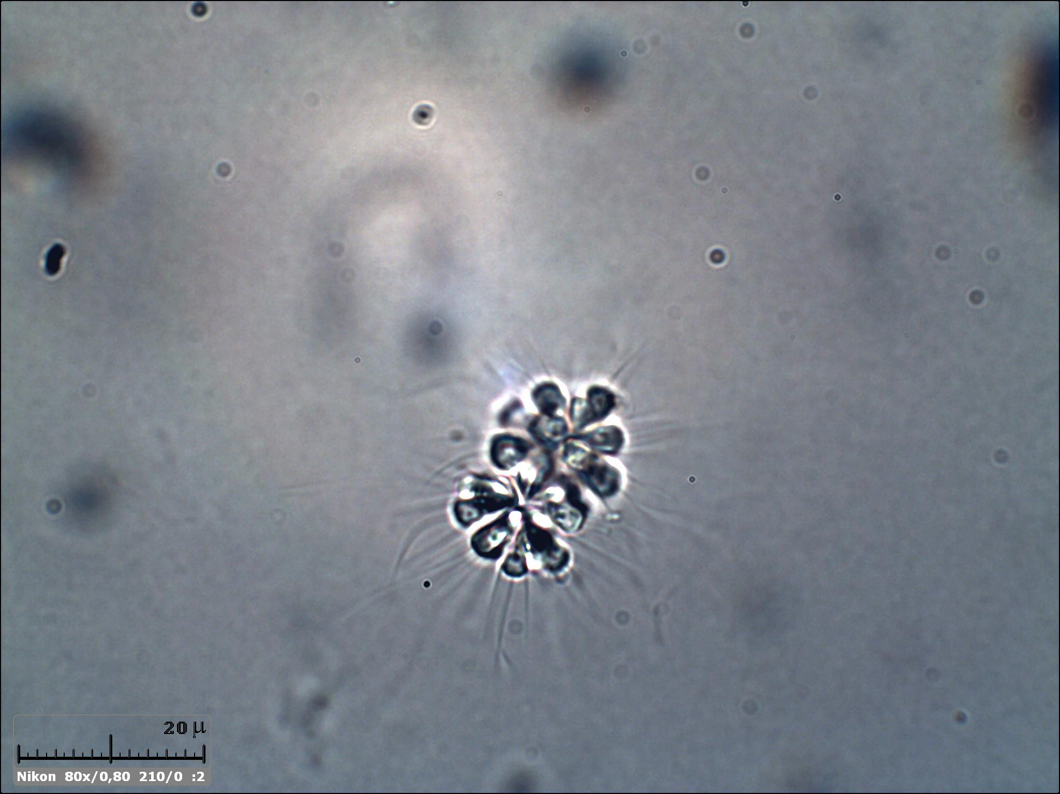
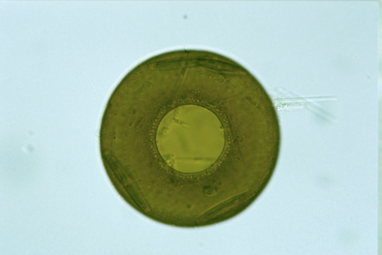
Environmental Microorganism Image Analysis Using Deep Learning
yykkll
Benjamin Wu (z5161230)
Jiaqi Wang (z5213190)
Raymond Hua (z5214828)
Ruizhi Xu (z5038007)
Ziyao Wei (z5306143)

Slide 2
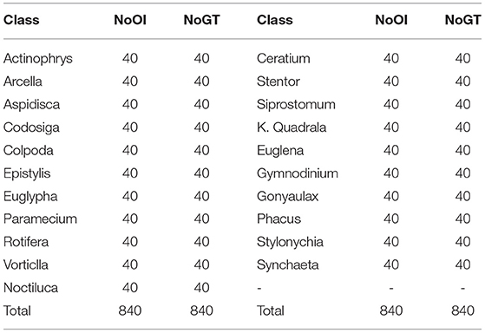
Motivation
Challenging Dataset Size: The EMDS-6 dataset's extremely small size presents significant challenges for various machine learning models. We want explore strategies for image classification and segmentation with minimal data, which are common in many real-world applications where data collection is costly or limited.
Presenter: Ruizhi Xu (z5038007)

Slide 3
Problem Statement
Environmental microorganisms (EMs) are ubiquitous and significantly impact humansurvivaland development. The detection and identification of these microorganisms are crucial for various applications,including environmental monitoring, disease prevention, and industrial processes.
Traditional methods of identifying EMs involve manual microscopic analysis, which is labor-intensive, time-consuming, and prone to human error.
This project aims to develop an automated system for analyzing EM images using deep learning techniques. The goal is to enhance the accuracy and efficiency of tasks such as image denoising, segmentation, feature extraction, classification, and object detection.
Presenter: Ruizhi Xu (z5038007)

Slide 4
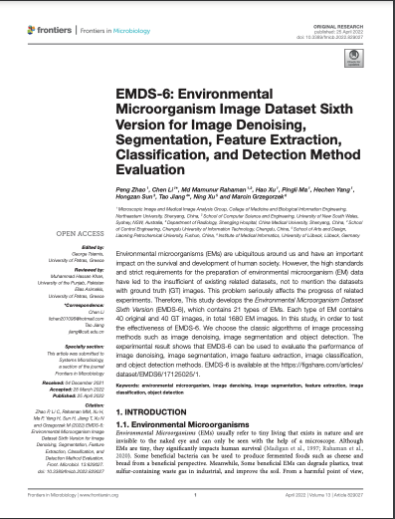
Literature Review - 1
Dataset Versatility and Application: The EMDS-6 dataset is designed to evaluate various image processing techniques such as denoising, segmentation, and classification, making it a versatile tool for developing and testing AI algorithms focused on image analysis.
Performance Benchmarking: The dataset allows for comprehensive testing of different noise types and image processing filters, providing a robust benchmark for comparing the effectiveness of traditional machine learning models and deep learning approaches in handling real-world, noisy datasets.
Presenter: Ruizhi Xu (z5038007)

Slide 5
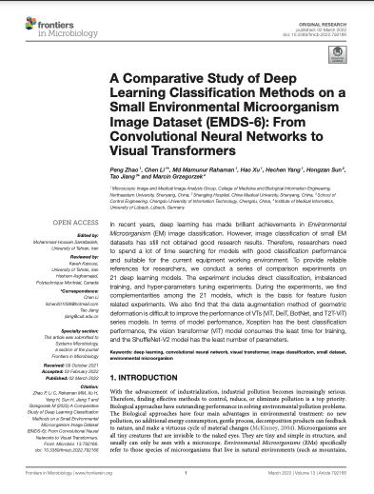
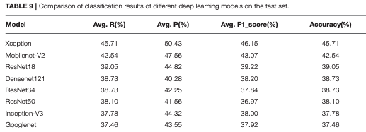
Literature Review - 2
This study provides an analysis table of the differences between the 18 models. This result can help related research on feature fusion quickly find models with significant differences and improve model performance.
1. The experimental results prove that the Xception network is suitable for this kind of task.
2. After data augmentation, the accuracy of CNN series models improves significantly
3. VT series models are highly limited on the small size dataset
Presenter: Ruizhi Xu (z5038007)

Slide 6
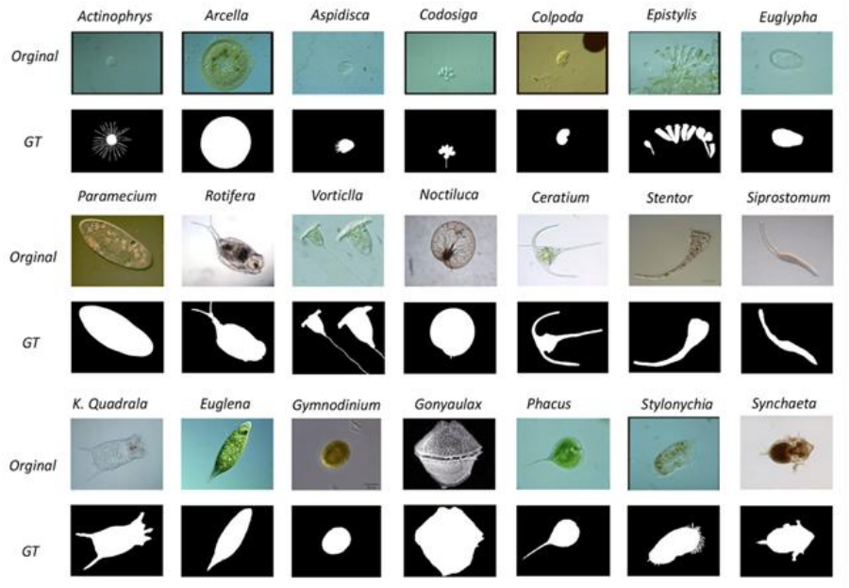
Dataset(s)
The EMDS-6 dataset comprises 1680 images,
featuring 21 distinct classes of original EM images, each class containing 40 images.
This totals 840 original images, with each accompanied by a corresponding GT image, also totaling 840.
Presenter: Ruizhi Xu (z5038007)

Slide 7
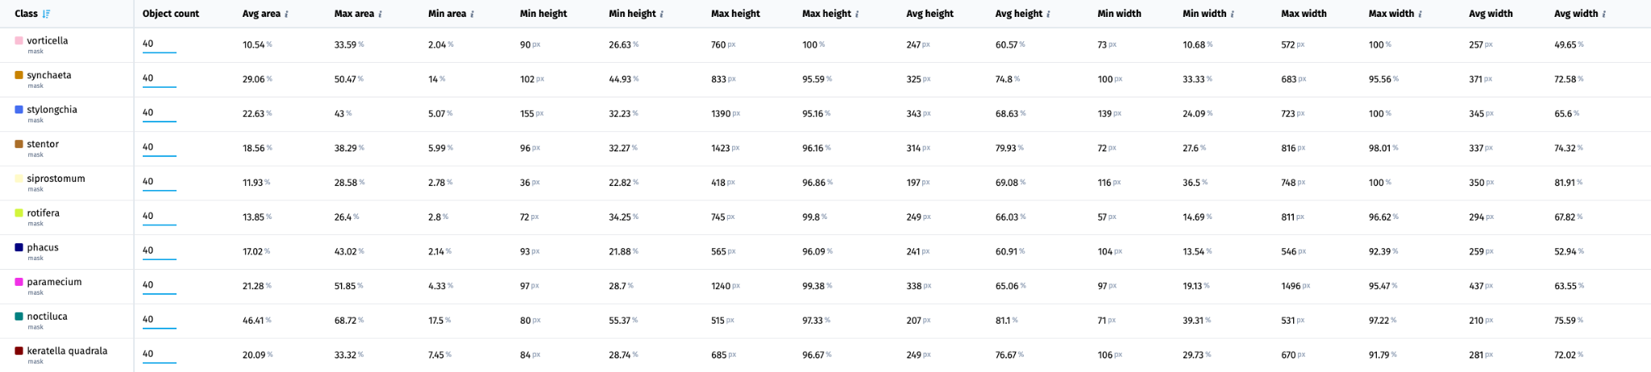
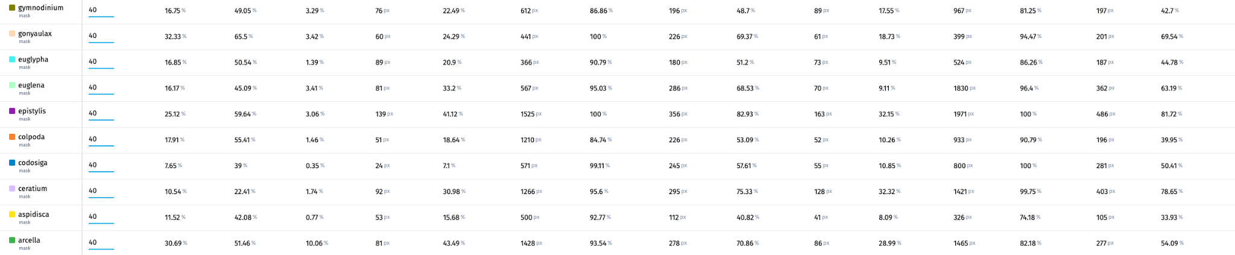
Data Analysis – Class Size
Presenter: Ruizhi Xu (z5038007)

Slide 8
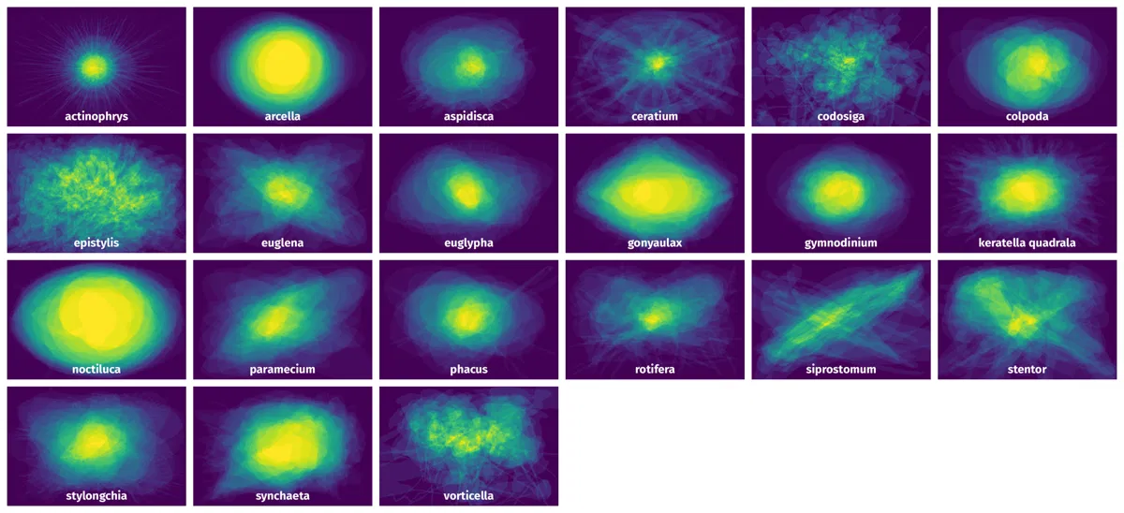
Data Analysis – Spatial Heatmap
Presenter: Ruizhi Xu (z5038007)

Slide 9
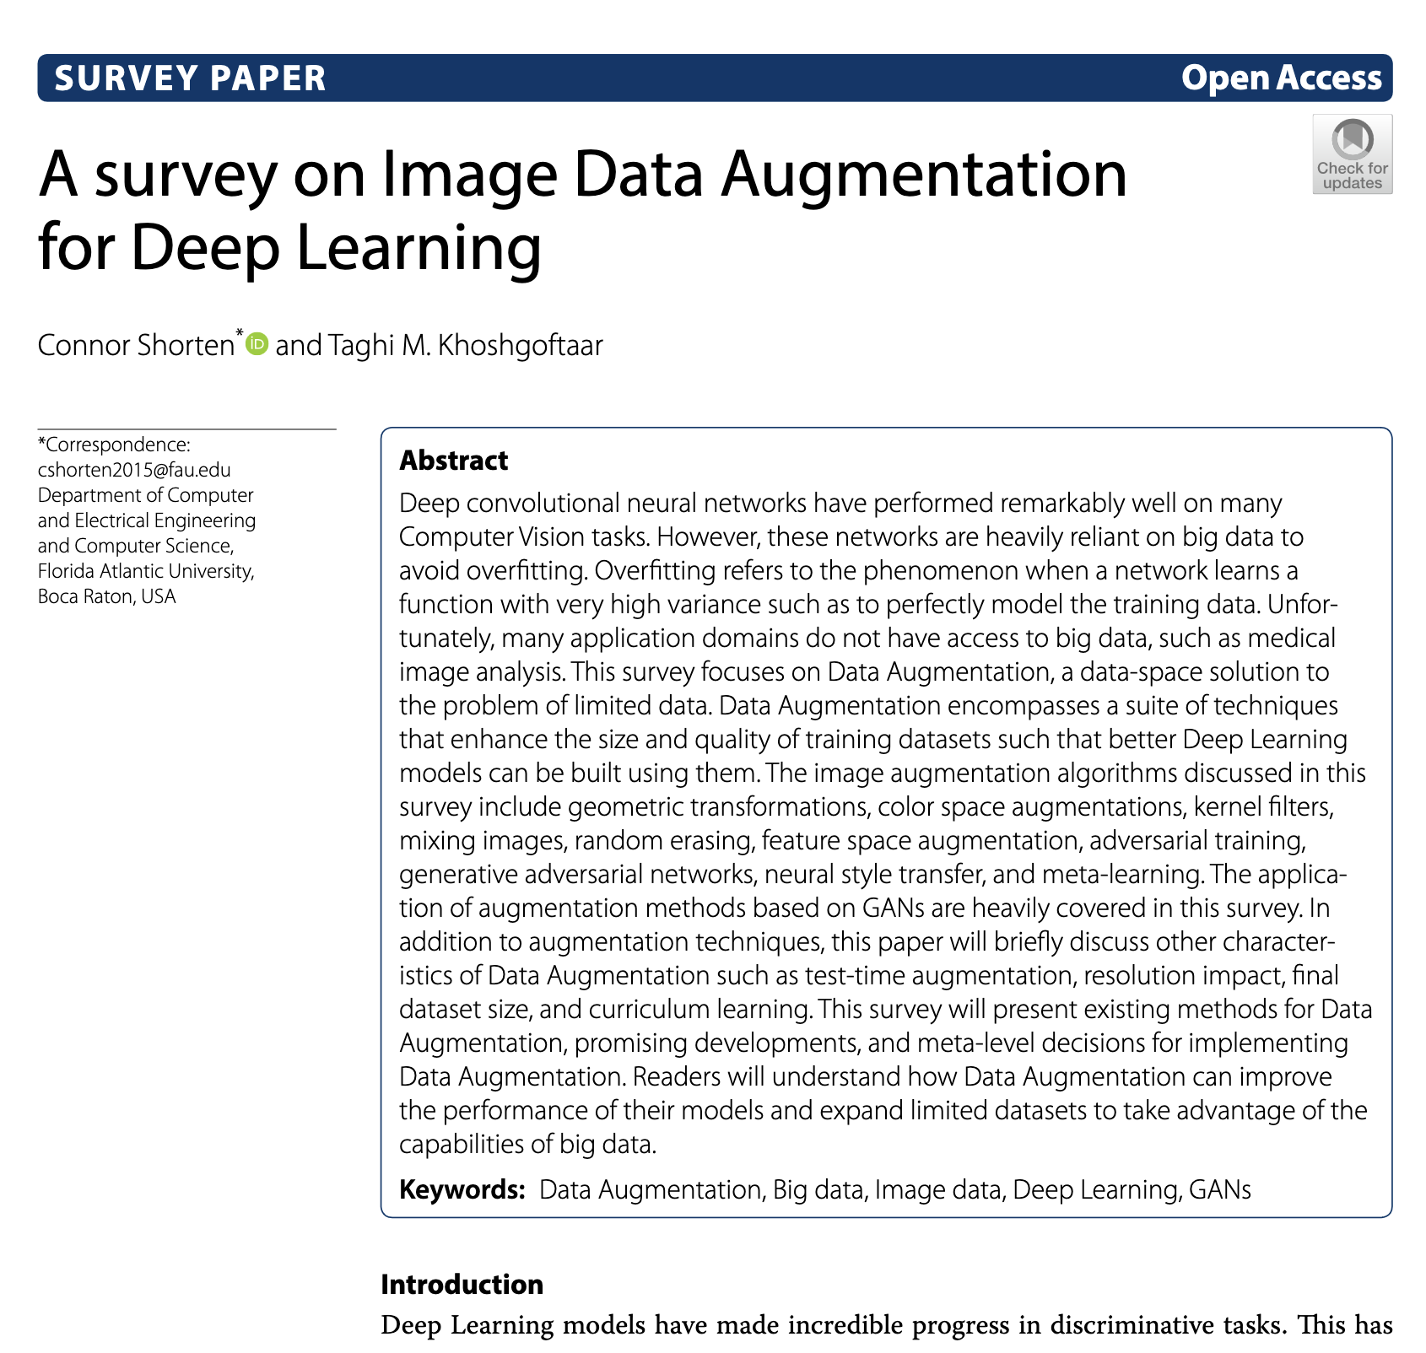
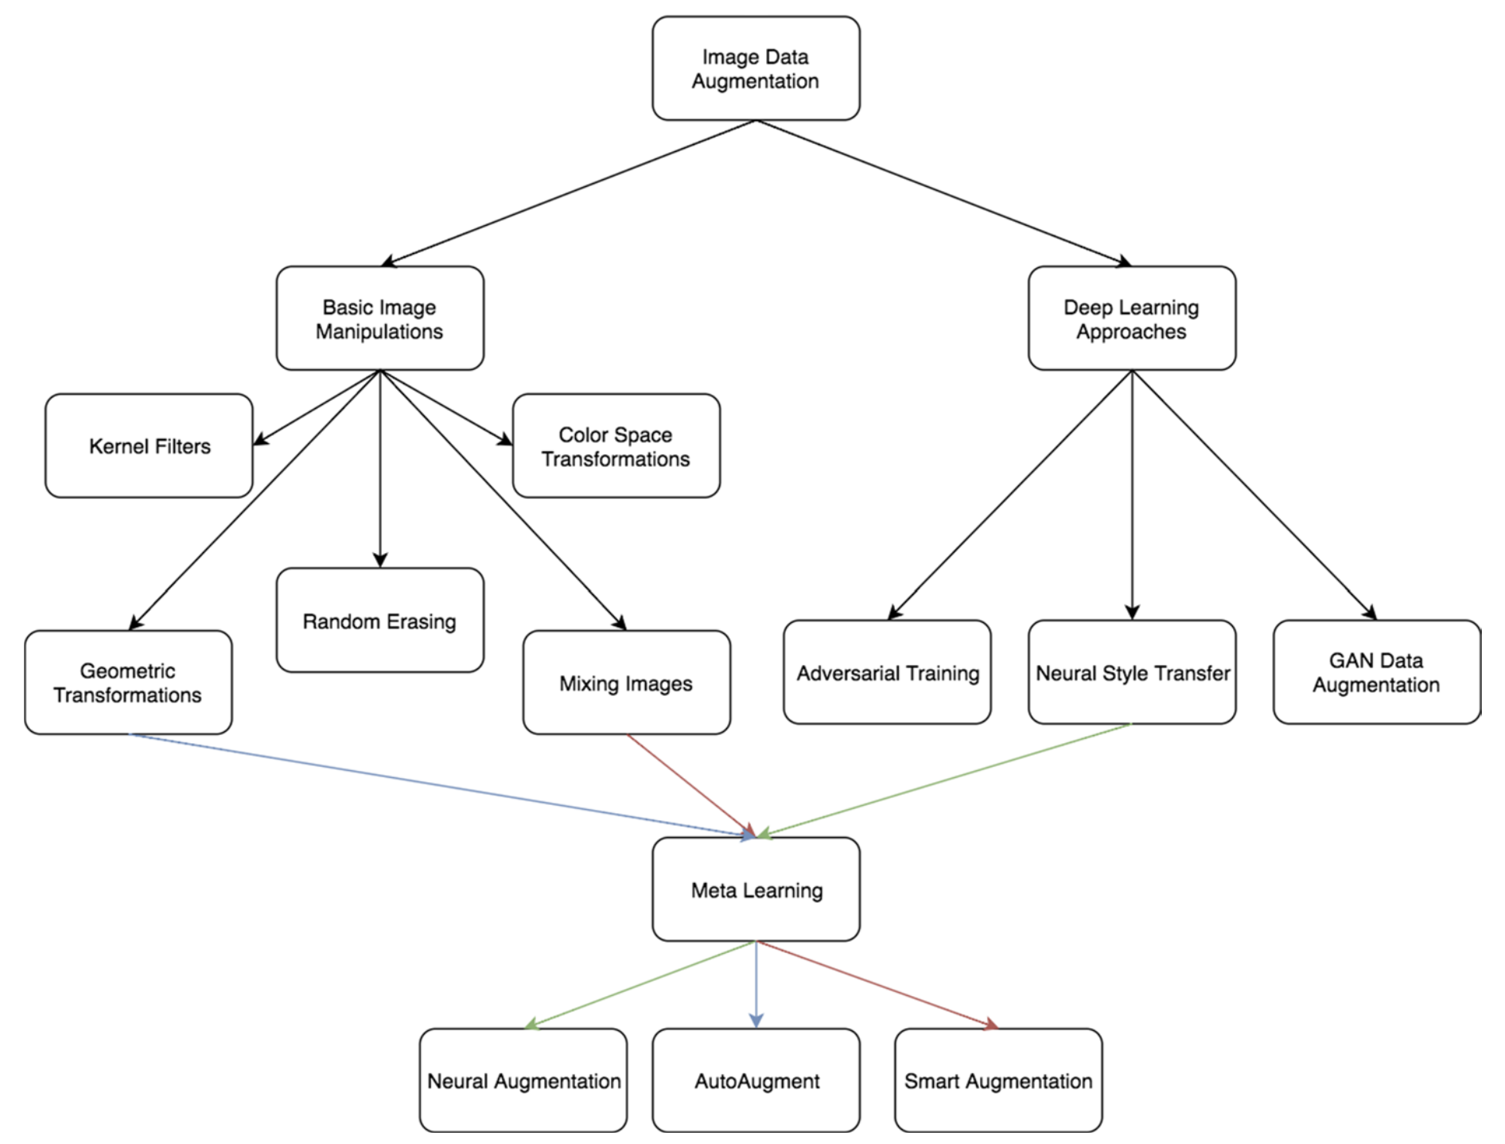
Literature Review - Data Augmentation
This study looks at the various data augmentation techniques that can be applied to Deep Learning models. It provides background on how these techniques can improve model performance and the disadvantages/limitations of each technique.
Presenter: Raymond Hua (z5214828)

Slide 10
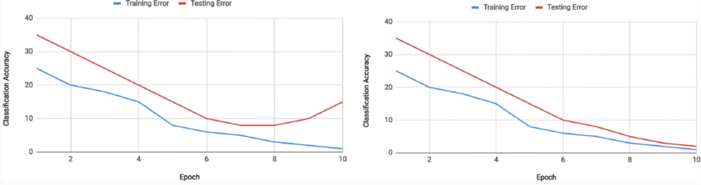
Preprocessing - Data Augmentation
Why do we need to augment our data?
Increase the dataset size - very costly to manually source new data
Increased generalizability - model can be applied to new data effectively
Increased robustness - account for data imperfections when encountering new data
Improved model performance
Presenter: Raymond Hua (z5214828)

Slide 11
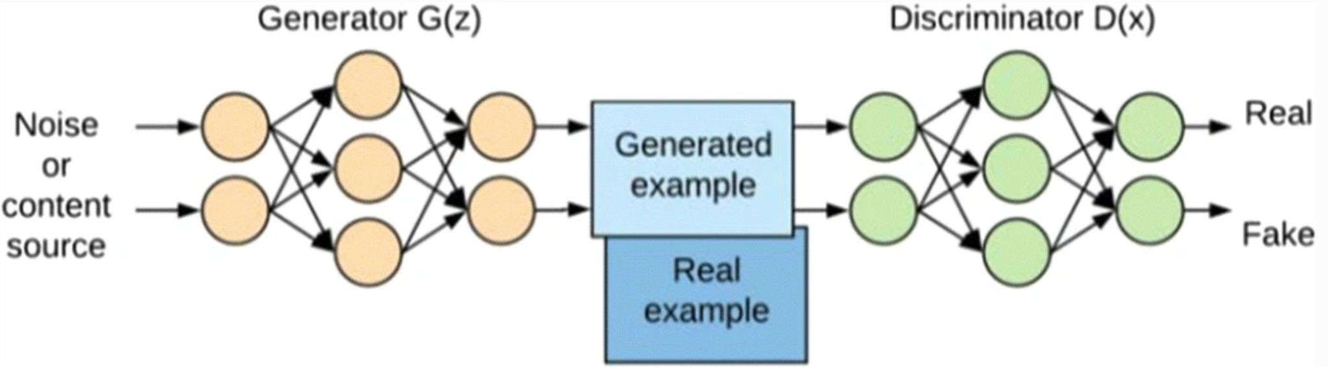
Preprocessing - Data Augmentation Techniques
What are the different data augmentation techniques?
Geometric Transformations (flipping, rotation, cropping)
Colour space transformations (brightness)
Noise insertion
Kernel filters (blur/sharpen)
Generative Adversarial Networks (GANs)
Concerns
Overfitting
Presenter: Raymond Hua (z5214828)

Slide 12
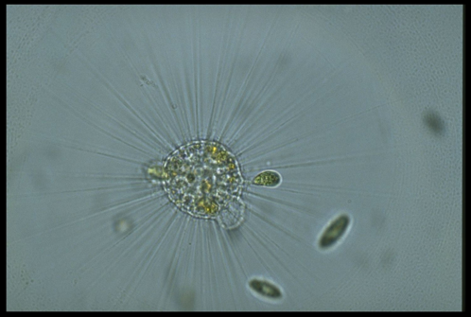
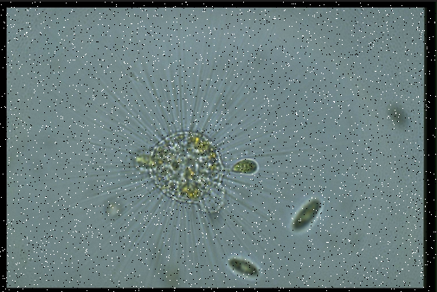
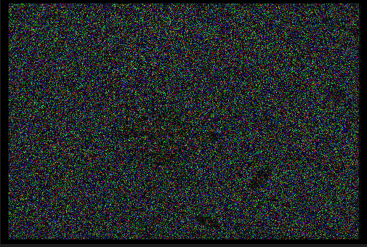
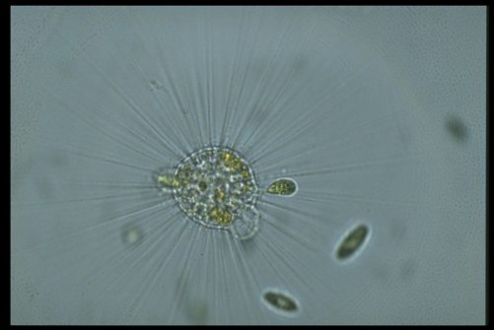
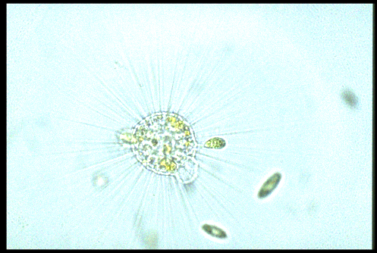
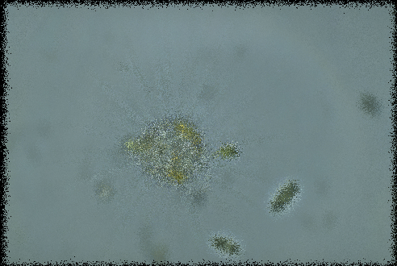
Replication of Noise Effects on top of Original Image
Original Image
Salt and Pepper Noise
Multiplicative Noise
Gaussian Noise
Poisson Noise
Poisson Gaussian Noise
Presenter: Benjamin Wu (z5161230)

Slide 13
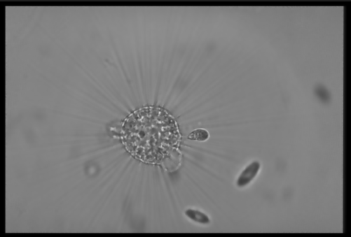
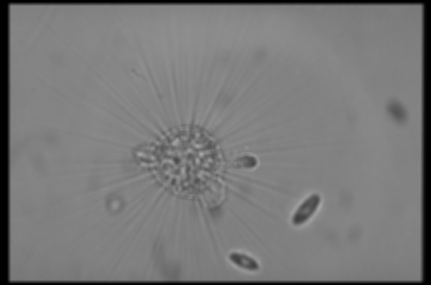
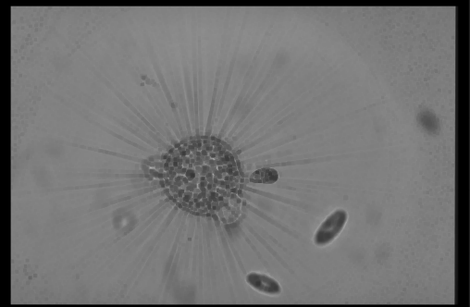
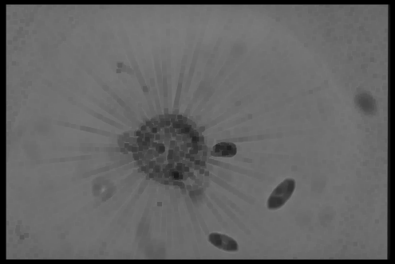
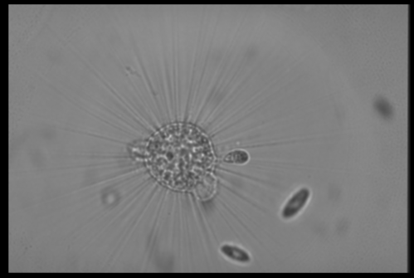
Replication of Different Filters
Wiener Filter 5x5
Window Mean Filter 5x5
Maximum Filter
Minimum Filter
Rank Order Filter
Geometric Mean Filter
Presenter: Benjamin Wu (z5161230)

Slide 14
Model - autoencoder
Autoencoder Model Overview
Model architecture and training process
Observations
Presenter: Ziyao Wei (z5306143)

Slide 15
Autoencoder Model Overview
Introduction to Autoencoders
Learn efficient data representations
Used for dimensionality reduction and feature learning
Encoder
Compresses input data into a latent space
Utilizes convolutional layers for feature extraction
Pooling layers reduce dimensionality
Decoder
Reconstructs data from the latent representation
Uses transposed convolutional layers to upsample data
Application in Project
Trained to denoise images
Minimizes reconstruction loss between noisy and clean images
Presenter: Ziyao Wei (z5306143)

Slide 16
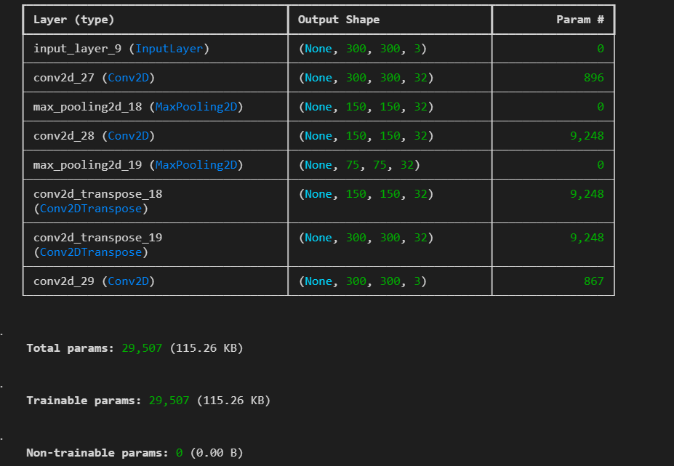
Model architecture and training process
Presenter: Ziyao Wei (z5306143)

Slide 17
Observations
RGB
Grey
？
Presenter: Ziyao Wei (z5306143)

Slide 18
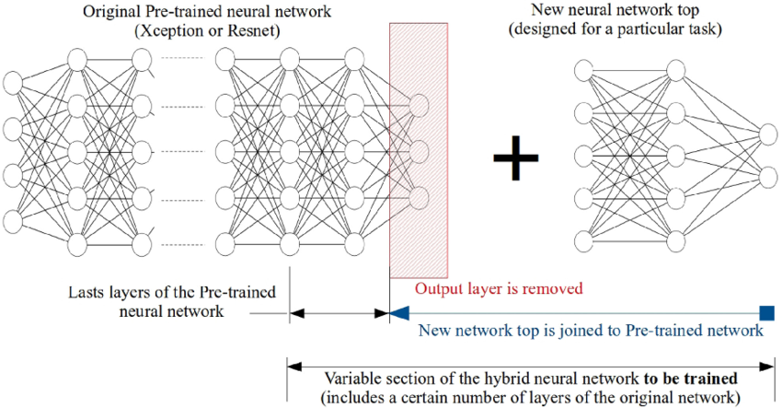
Method(s) – Classification
Use base pre-trained network, with a custom heads for our dataset (21 classes)
Transfer Learning architecture. | Download Scientific Diagram (researchgate.net)
Presenter: Jiaqi Wang (z5213190)

Slide 19
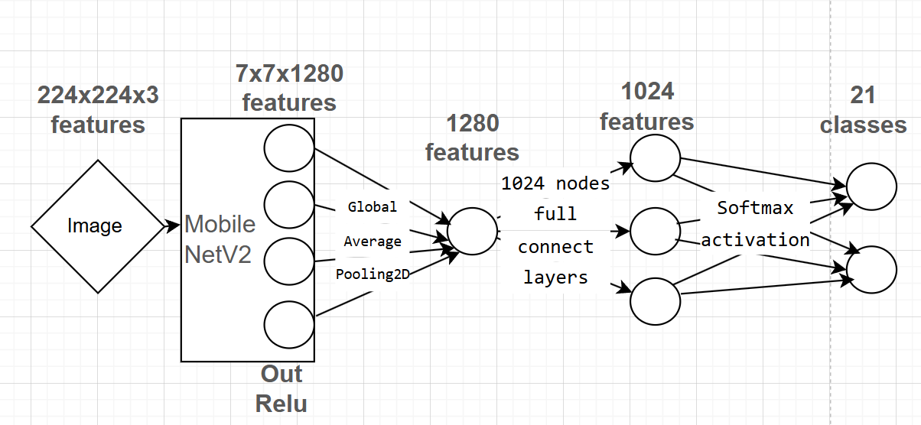
Transfer learning on MobileNetV2: Total params: 2,257,984
MobileNetV2’s feature extractor converts will convert the input of our dataset (224, 224, 3) 224x224x3 image to into a 7x7x1280 block of features. (None, 7, 7, 1280).
Presenter: Jiaqi Wang (z5213190)

Slide 20
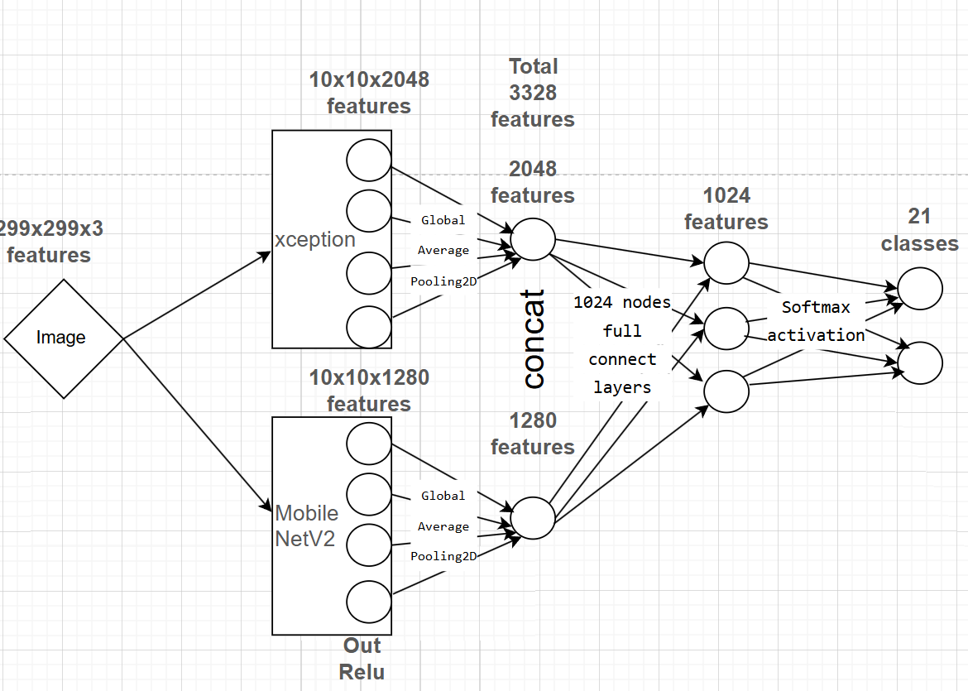
Model fusion: Total params: 26,549,885
Use two pretrained model to extract the feature. and get better performance.
Presenter: Jiaqi Wang (z5213190)

Slide 21
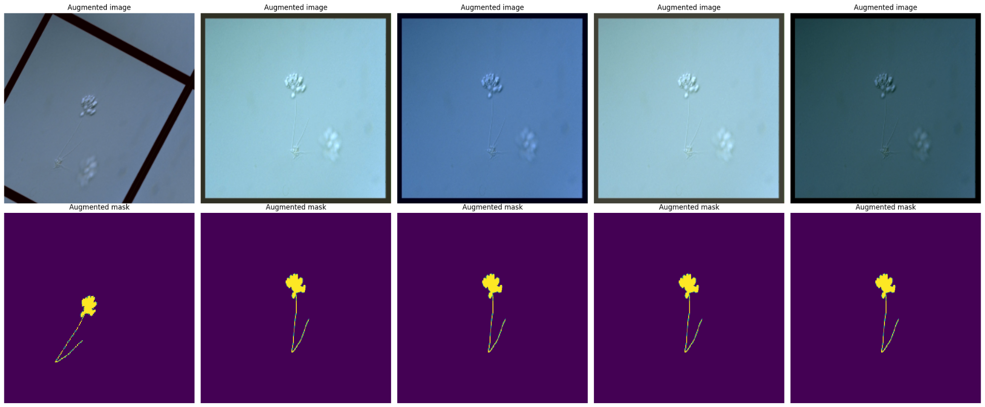
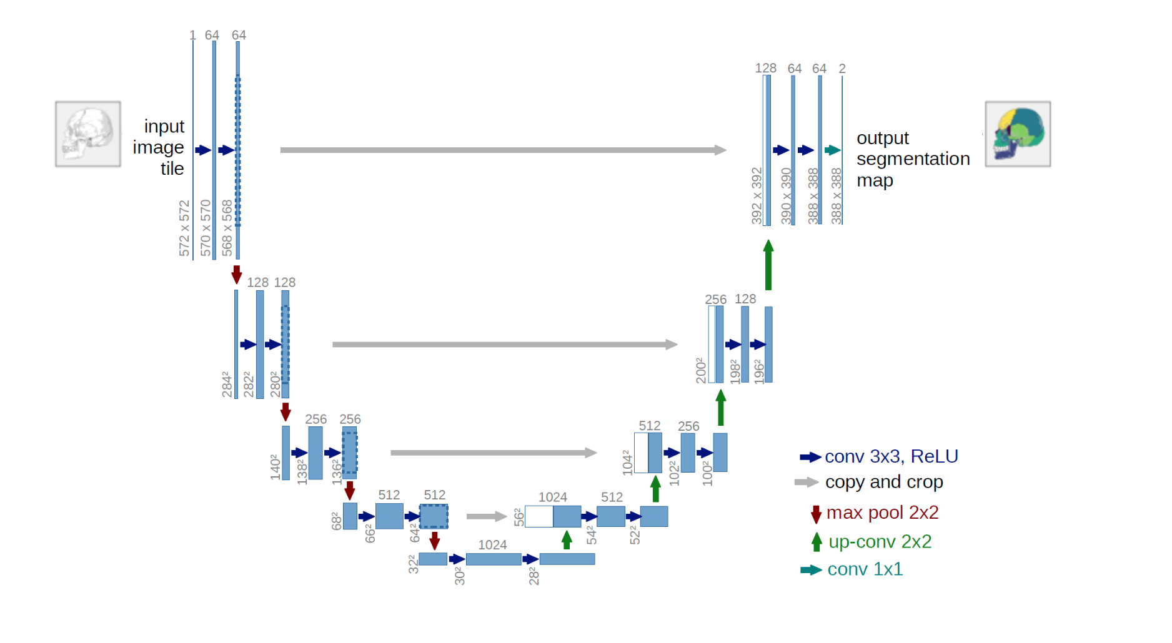
Method(s) – Segmentation
Image preprocessing & data argumentation method
albumentations is a computer vision tool that boosts the performance of deep convolutional neural networks.
ShiftScaleRotate
RGBShift
RendomBrightnessContrast
A deep learning-based segmentation method, Recurrent Residual CNN-based U-Net (U-Net) (Alom et al., 2019) are used in this experiment.
While using U-Net for segmentation, the learning rate of the network is 0.001 and the batch size is 1.
Presenter: Ruizhi Xu (z5038007)
Notes:
ShiftScaleRotate: Randomly apply affine transforms: translate, scale and rotate the input.
RGBShift
RandomBrightnessContrast

Slide 22
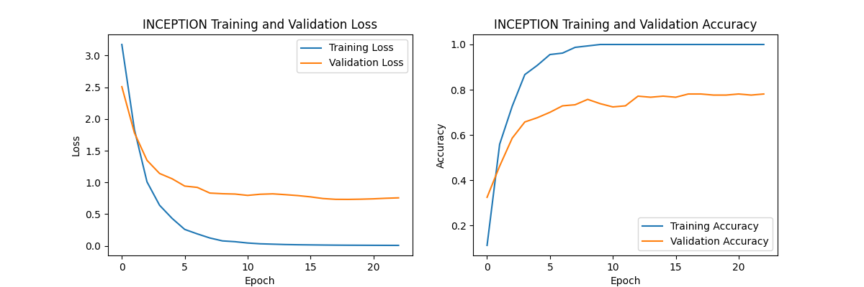
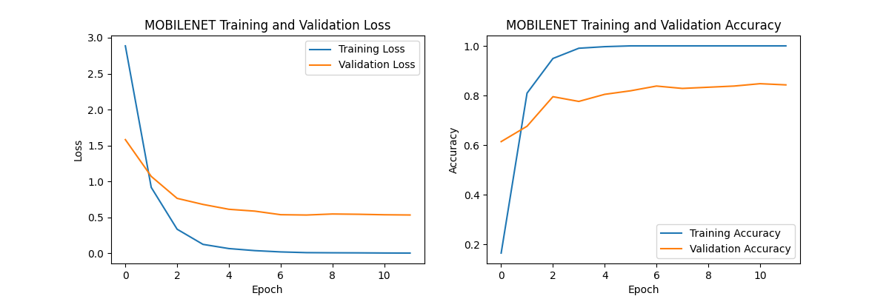
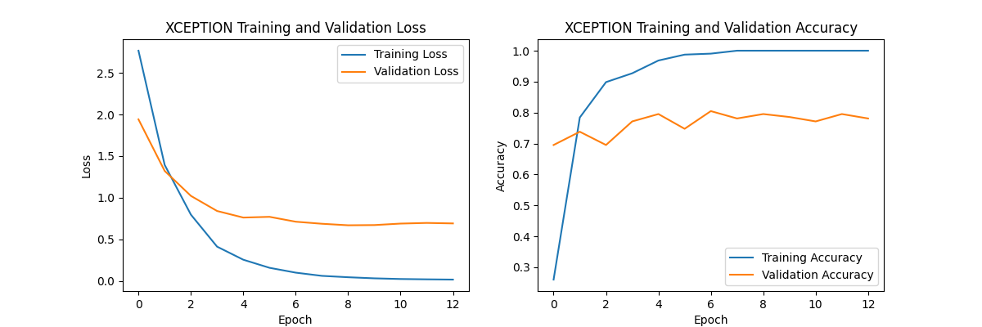
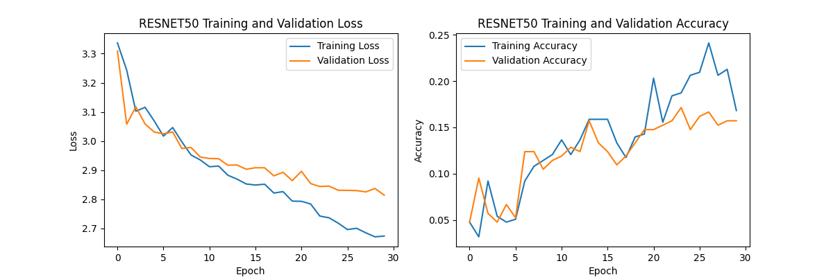
Results–Classification
Details here …
Presenter: Jiaqi Wang (z5213190)

Slide 23
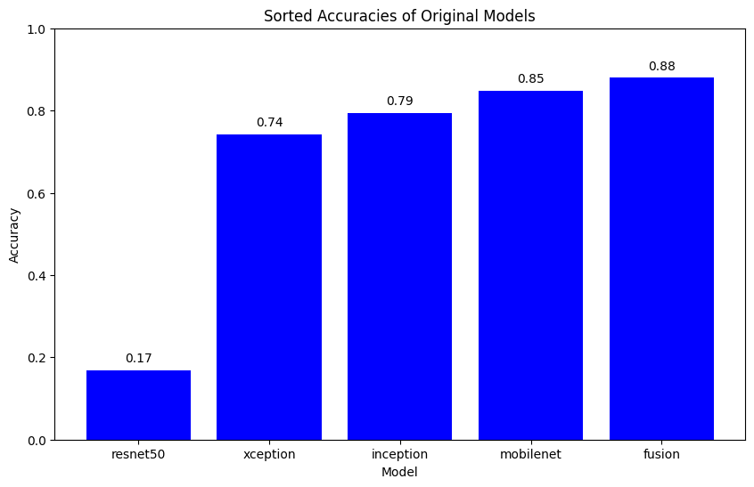
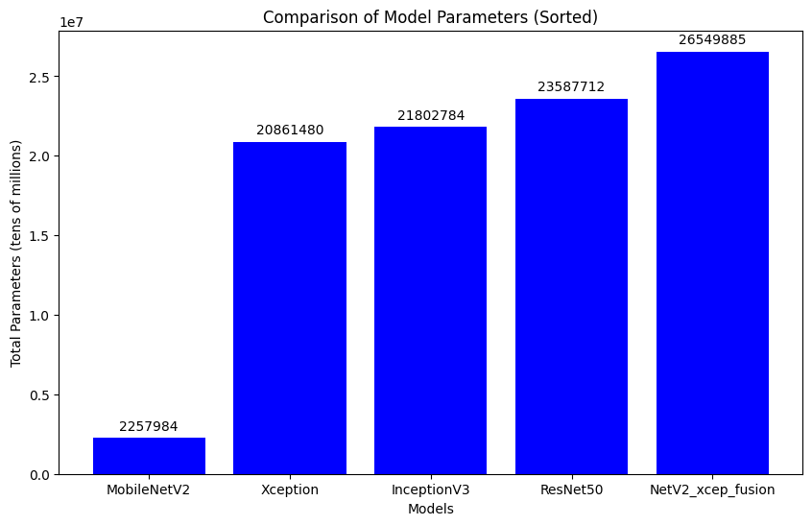
Xception: Total params: 20,861,480
MobileNetV2: Total params: 2,27,984
InceptionV3: Total params: 21,802,784
ResNet50: Total params: 23,587,712
Presenter: Jiaqi Wang (z5213190)

Slide 24
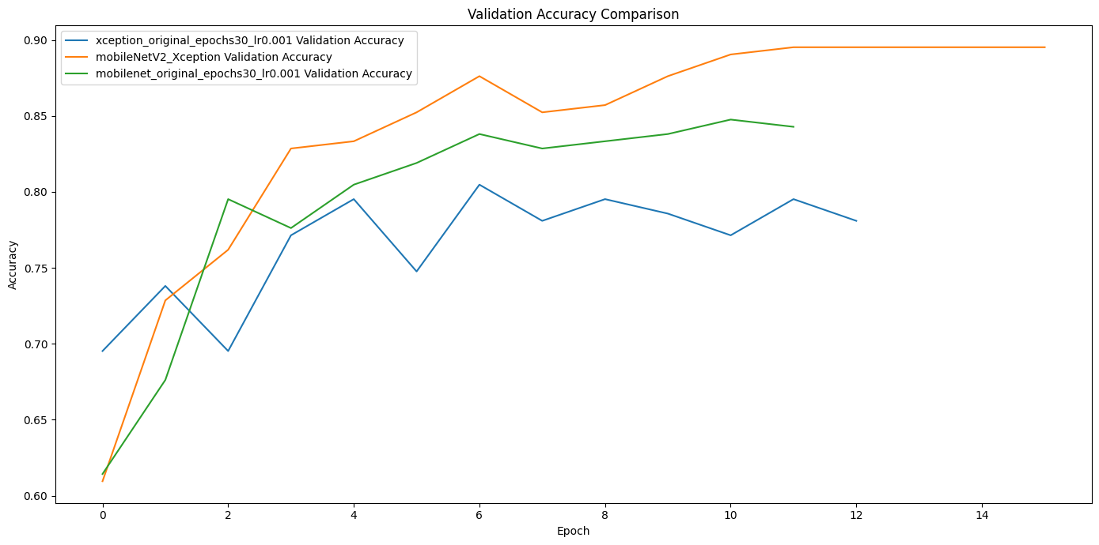
Model fusion: Total params: 26,549,885, fusion model get more performance but we need to have a tradeoff between accuracy and time of do the task.

Slide 25
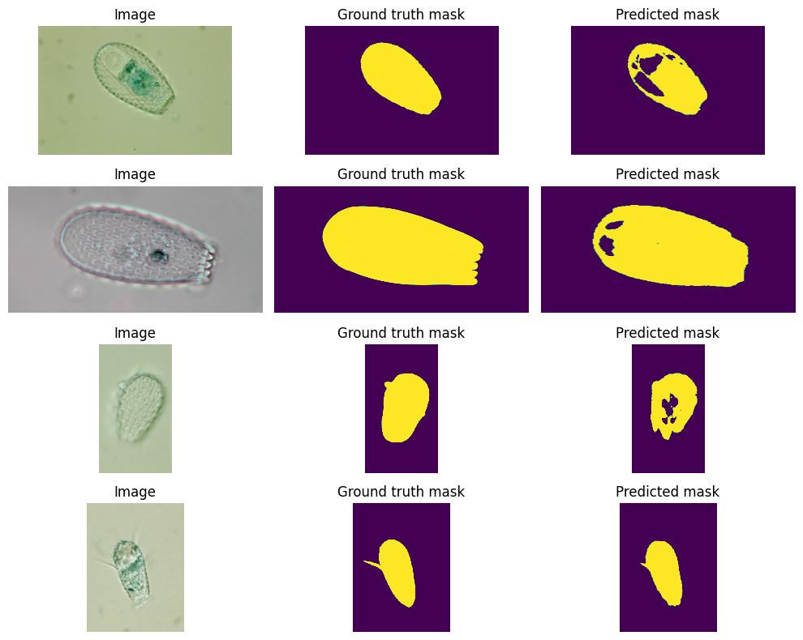
Results – Segmentation
Dice: 95%
Jaccard: 75%
Recal: 80%
Presenter: Ruizhi Xu (z5038007)

Slide 26

This Photo by Unknown Author is licensed under CC BY-SA

